Slide 1
Machine Learning (CS 361) 3 – 0 – 0 – 6 January - April 2023 Slot - D1: Monday, Tuesday (4 to 4.55 PM), Friday (3 to 3.55 PM)
Instructor
Arijit Sur
Office: H-103
Department of Computer Science and Engineering
Email: arijit@iitg.ac.in
Ph: 2361

Slide 2
TA Members
Anirban Lekharu (anirban2012@iitg.ac.in)
Sandipan Sharma (sandipan.sarma@iitg.ac.in)
Alik Pramanik (p.alik@iitg.ac.in)
Sonal Kumar (k.sonal@iitg.ac.in)
Vanshita Bansal (vanshitabansal@iitg.ac.in)
Sagar Kesarwani (k.sagar@iitg.ac.in)

Slide 3
Syllabus
Different types of Learning, Supervised Learning: Linear and logistic regression, similarity based learning (NN, K-NN), probability based learning (Bayes methods), error based learning (Neural Networks), discriminant function based learning (SVM), evaluation measures, information based learning (Decision trees).
Theory of generalization. Bias-variance trade-off.
Clustering (hierarchical clustering, partitional clustering, density based methods, graph based methods, non-negative matrix factorization, probabilistic methods, evaluation measures),
Dimensionality reduction (linear, non-linear): evaluation measures.
Regression Methods: SVR, logistic regression.
Density estimation methods: parametric, non-parametric, ensemble methods.
Reinforcement learning.

Slide 4
Books
Text Books:
O. Duda, P. E. Hart, D. Strok, Pattern classification, 2nd edition, Wiley, 2000.
Alpaydin, Introduction to Machine Learning, MIT Press, 2014.
Reference Books:
M. Bishop, Pattern Recognition and Machine Learning, Springer, 2011.
D. Kelleher, B. Mac Namee, A. D`arcy. Fundamentals of Machine Learning for Predictive Data Analytics - Algorithms, Worked Examples, and Case Studies, MIT Press, 2015.
Shalev-Shwartz, S. Ben-David, Understanding Machine Learning From Theory to Algorithms, Cambridge University Press, 2014.
Mitchell, Machine Learning, McGr

Slide 5
Evaluation
Percentage of Grade : TBA
Date of Test: TBA
MID and END Semester Exams
Quiz (Tentative)
Online Mode
MCQ (Tentative)

Slide 6
Today
Define Machine Learning
Applications
Different types of learning
Brief introduction of
Supervised learning
Unsupervised learning
Reinforcement learning

Slide 7
Machine Learning
Field of study that gives computers the ability to learn without being explicitly programmed.
By: Arthur Samuel (1959)

Slide 8
Applications
Database mining:
Web click data, medical records, biology, engineering etc.
Application that can’t be programmed by hand
Autonomous helicopter, handwriting recognition, NLP, computer vision
Self Customizing Programs Recommendation
Amazon, Netflix
Understanding human learning
Brain, real AI

Slide 9
Learning Problem
Well-posed learning problem:
A computer program is said to learn from experience E with respect to some task T and some performance measure P, if its performance on T, as measured by P, improves with experience E.
By Tome Mitchell (1998)

Slide 10
Example
Your Email program watches which emails you do or do not mark as a spam and based on that learns how to better filter spam.
Task (T): Classifying the emails as spam or not
Experience (E): Watching you label emails as spam or not spam
Performance (P): The number of emails correctly classified as spam / not spam

Slide 11
Different Types of Learning
Supervised Learning: Data and corresponding labels are given
Unsupervised Learning: Only data is given, no labels provided
Semi-supervised Learning: Some (if not all) labels are present
Reinforcement Learning: An agent interacting with the world makes observations, takes actions, and is rewarded or punished; it should learn to choose actions in such a way as to obtain a lot of reward

Slide 12
Supervised Learning
Supervised learning: classification is seen as supervised learning from examples.
Supervision: The data (observations, measurements, etc.) are labeled with pre-defined classes. It is like that a “teacher” gives the classes (supervision).
Test data are classified into these classes too.

Slide 13
Supervised learning
Like human learning from past experiences.
A computer does not have “experiences”.
A computer system learns from data, which represent some “past experiences” of an application domain.
Our focus: learn a target function that can be used to predict the values of a discrete class attribute, e.g., approve or not-approved, and high-risk or low risk.
The task is commonly called: Supervised learning, classification, or inductive learning.

Slide 14
The data and the goal
Data: A set of data records (also called examples, instances or cases) described by
k attributes: A₁, A₂, … A_{k}.
a class: Each example is labelled with a pre-defined class.
Goal: To learn a classification model from the data that can be used to predict the classes of new (future, or test) cases/instances.
Notes:
Induction is different from deduction and DBMS does not not support induction;
The result of induction is higher-level information or knowledge: general statements about data
There are many approaches. Refer to the lecture notes for CS3244 available at the Co-Op.
We focus on three approaches here, other examples:
Other approaches
Instance-based learning
other neural networks
Concept learning (Version space, Focus, Aq11, …)
Genetic algorithms
Reinforcement learning

Slide 15
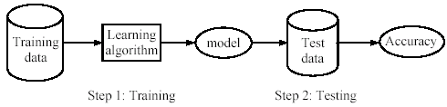
Supervised learning process: two steps
Learning (training): Learn a model using the training data
Testing: Test the model using unseen test data to assess the model accuracy

Slide 16
Fundamental assumption of learning
Assumption: The distribution of training examples is identical to the distribution of test examples (including future unseen examples).
In practice, this assumption is often violated to certain degree.
Strong violations will clearly result in poor classification accuracy.
To achieve good accuracy on the test data, training examples must be sufficiently representative of the test data.

Slide 17
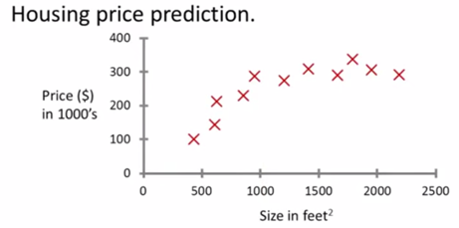
Supervised Learning: An example
Supervised Learning:
Right answer given
Regression:
Predict continuous valued output

Slide 18
Supervised Learning: An example
Fruit : Apple or not?
Classification
Discrete values output (0 or 1)
1(Y)
Binary classifier
Multi-class classifier
0(N)
Fruit size

Slide 19
Supervised Learning: An example
Fruit : Apple or not?
Features:
color
texture
cost
…..
Weight
Fruit size
Two features examples

Slide 20
Supervised Learning
x₂
x₁

Slide 21
Un-supervised Learning
No label
Clustering Algorithm
x₂
x₁

Slide 22
Supervised vs. unsupervised learning
Supervised learning: discover patterns in the data that relate data attributes with a target (class) attribute.
These patterns are then utilized to predict the values of the target attribute in future data instances.
Unsupervised learning: The data have no target attribute.
We want to explore the data to find some intrinsic structures in them.

Slide 23
Clustering
Clustering is a technique for finding similarity groups in data, called clusters. i.e.,
it groups data instances that are similar to (near) each other in one cluster and data instances that are very different (far away) from each other into different clusters.
Clustering is often called an unsupervised learning task as no class values denoting an a priori grouping of the data instances are given, which is the case in supervised learning.
Due to historical reasons, clustering is often considered synonymous with unsupervised learning.
In fact, association rule mining is also unsupervised

Slide 24
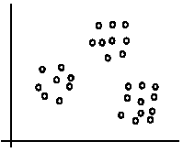
An illustration
The data set has three natural groups of data points, i.e., 3 natural clusters.
1-Jan-23

Slide 25
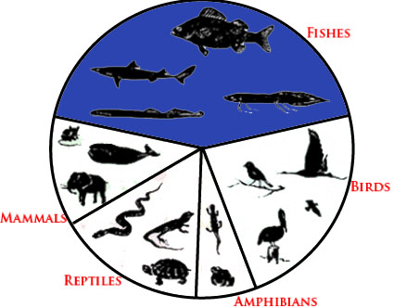
What is clustering for?
Clustering for Animal Kingdom

Slide 26
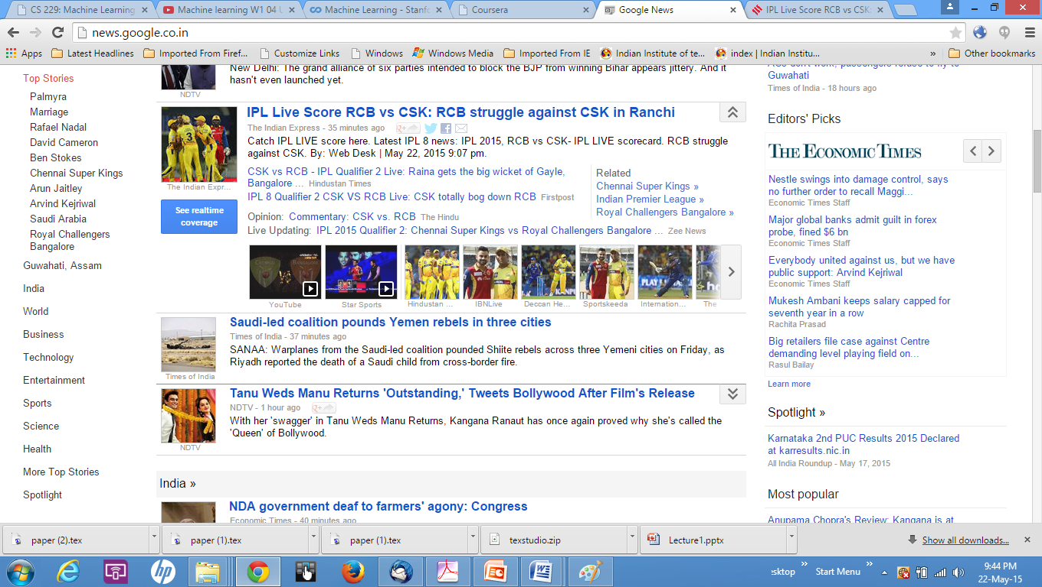
Google News:

Slide 27
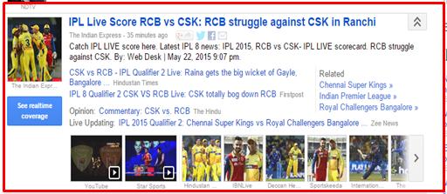

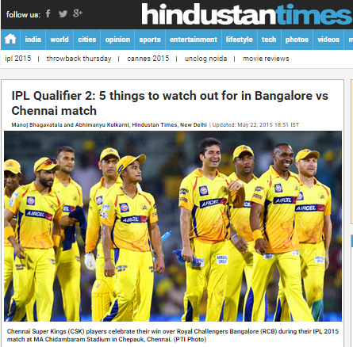

Slide 28
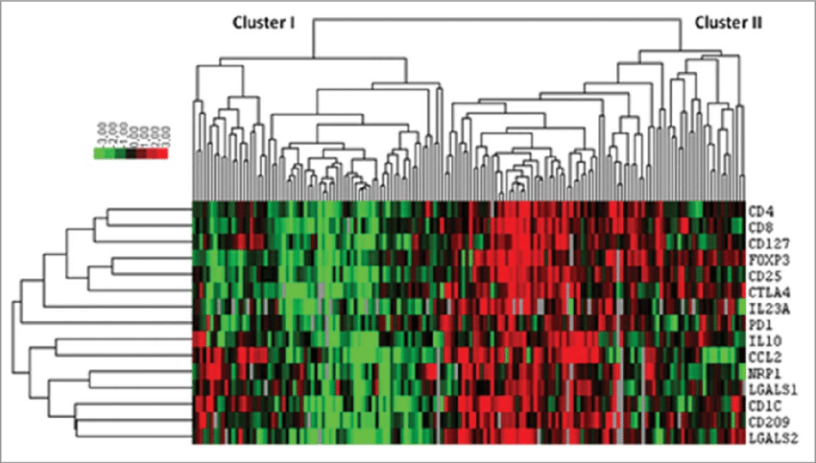
Clustering for Gene Expression

Slide 29
Application of Clustering Algorithms
Organizing computer clusters
Social network analysis
Market segmentation
Astronomical image/data analysis
Speaker recognition and many more…

Slide 30
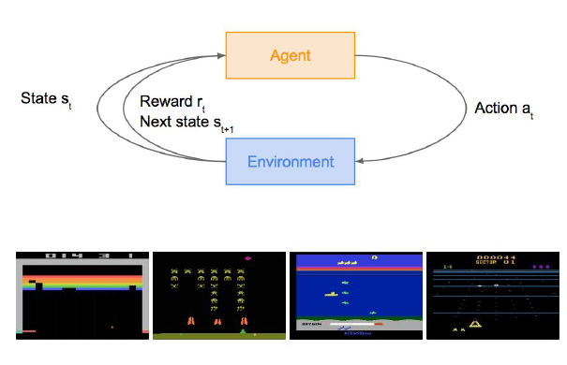
Reinforcement Learning
Problems involving an agent interacting with an environment, which provides numeric reward signals
Goal: Learn how to take actions in order to maximize reward

Slide 31
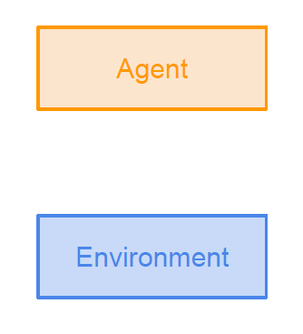
Reinforcement Learning

Slide 32
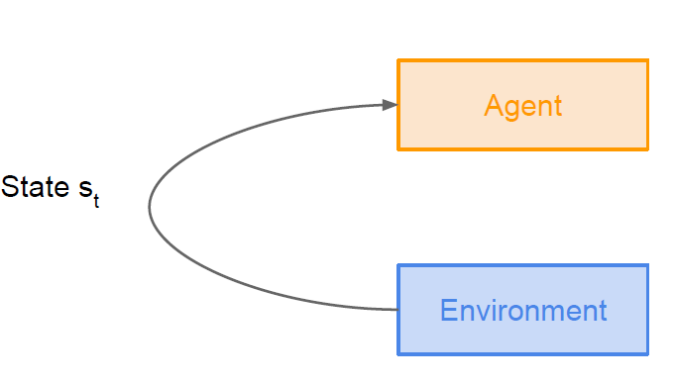
Reinforcement Learning

Slide 33
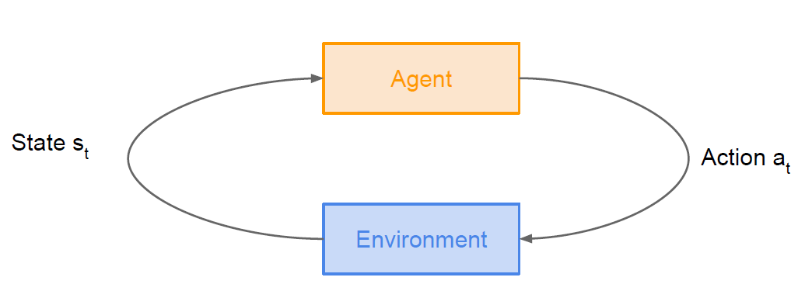
Reinforcement Learning

Slide 34
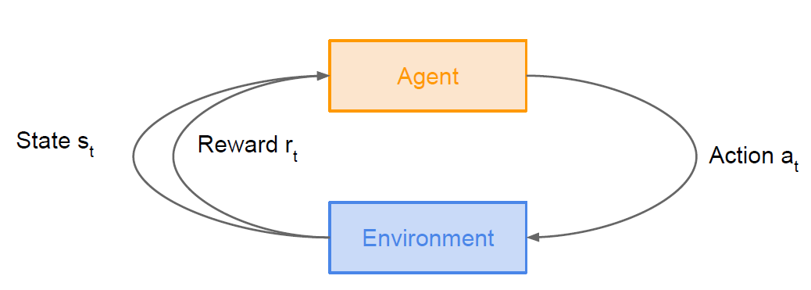
Reinforcement Learning

Slide 35
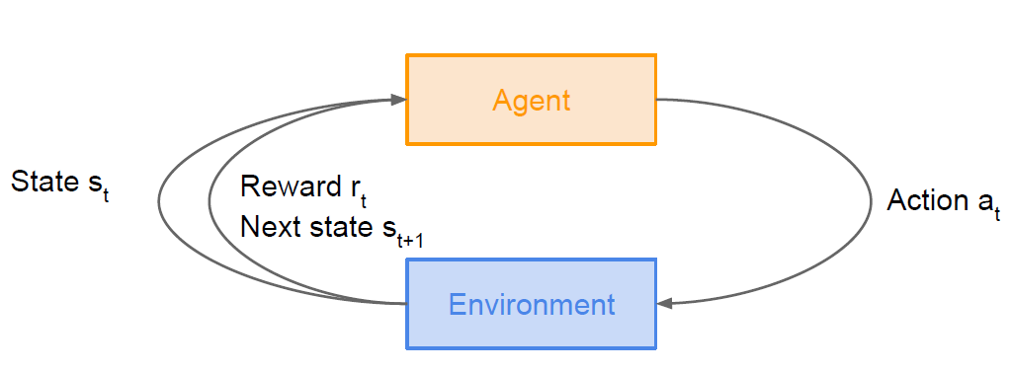
Reinforcement Learning

Slide 36
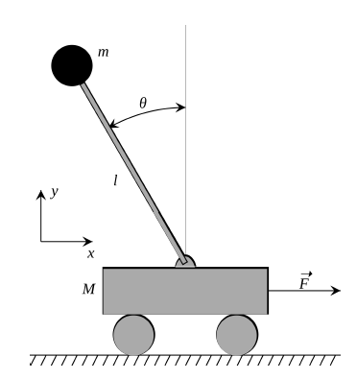
Cart-Pole Problem
Objective : Balance a pole on top of a movable cart
State : angle, angular speed, position, horizontal velocity
Action : horizontal force applied on the cart
Reward : 1 at each time step if the pole is upright

Slide 37
… to continue

